Slide 1
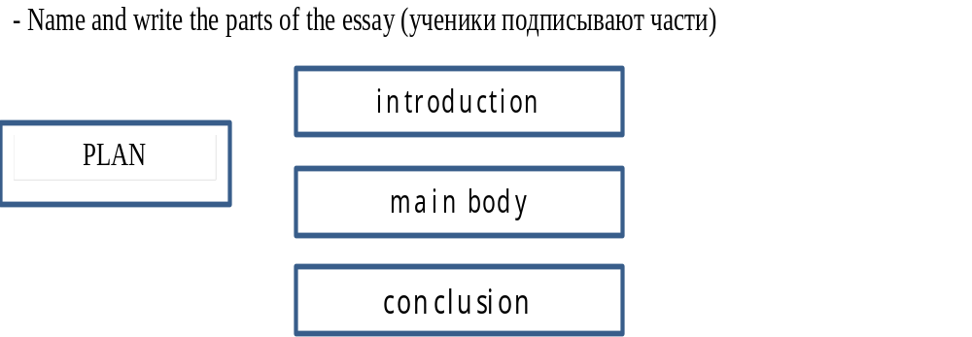

Slide 2
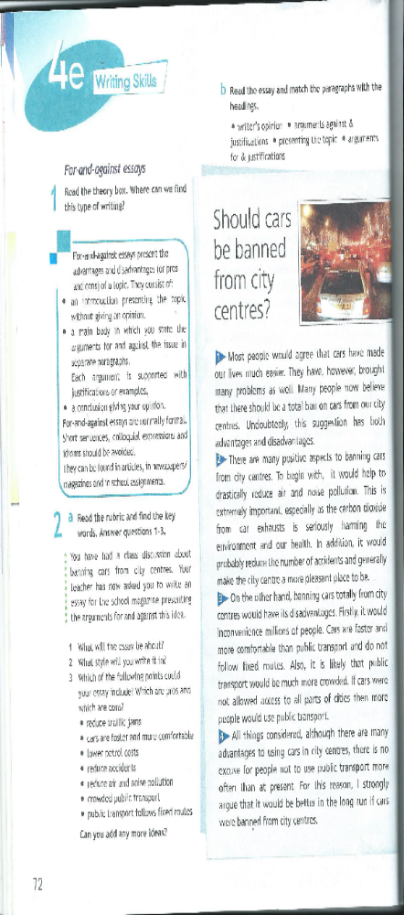

Slide 6
Firstly, To begin with, Secondly, Finally
Consequently, As a result, For this reason
Also, In addition, What is more, Not only…but…
However, Nevertheless, although, but, while, On the one hand…, On the other hand…
To sum up, To summarize, All in all, On the whole, All things considered

Slide 7
There are many positive aspects to cycle to work.
Genetically modified crops have their disadvantages.
There are many advantages to animal conservation programmes.
The environmental programmes are very expensive.
Women are more concerned about fitness then men.
People can learn foreign languages only abroad.
Some young people have become addicted to online gaming.
The Internet helps teenagers to widen their knowledge.
We should be careful using the Internet.
Animals shouldn’t be kept in zoos.

